Slide 1

Pseudo Panel data for Model Parameterisation
Applications for dynamic microsimulation modelling at the National Institute
Justin van de Ven

Slide 2
Outline
Microsimulation at the NIESR
Model parameterisation
  The challenge
  Implemented approach
  Motivation
Comparability of pseudo panel data through time
  Income
  Consumption
  Savings rates
Summary

Slide 3
Microsimulation at the Niesr
A Structural Dynamic Microsimulation model to project the two principal economic margins of decision making:
  labour / leisure
  consumption / savings
Model designed to simulate panel data for each individual in a reference population described by survey data
Core set of simulated characteristics:
age - relationship status - children
wage potential - pension wealth - nonpension wealth
retirement - migration status - time of death

Slide 4
Microsimulation at the Niesr
Objective function:
Uncertainty taken into account
  Based on Dynamic Programming methods
Van de Ven, J. (2017), Economic Modelling, 63, pp. 161-74.

Slide 5
Challenge of Model parameterisation
The model is designed to explore aspects of medium to long-term planning – savings, and retirement. The challenge is to design a coherent strategy to parameterise this model
  The focus of our model on medium term planning suggests the use of extended time-series data for parameterisation.
  This research avenue has not been fully pursued due to:
    persistent questions concerning data comparability
    difficulties associated with capturing the evolving policy context, including measures of uncertainty
Van de Ven, J. (2017), International Journal of Microsimulation, 10, pp. 135-166

Slide 6
Parameterisation method Adopted
Parameters partitioned into two sets:
  observable
    marital rates, divorce rates, fertility rates, mortality rates
  unobservable
    preference parameters, dynamics of wage potential (Heckman selection)
Observable model parameters
  based on time-series survey data and official projections
Preference parameters
  adjusted to match simulated consumption and employment behaviour to moments described by data for a single population cross-section
Wage parameters
  adjusted to reflect moments described by pseudo panel data

Slide 7
Motivation for adopted approach
Reflect official assumptions for margins orthogonal to principal focus of interest
    mortality, relationship status, fertility
    validity of these statistics ignored (e.g. persistent errors in mortality rates)
Behaviour central to the model is parameterised on data observed at a single point in time
    a single policy context
    ignore dynamics of measurement error in reported data
    ignore changing variable definitions through time
    assumptions required concerning inter-cohort variation
Capture wage growth by age and birth cohort as described by survey data sources
    a primary margin for the development of inter-cohort (economic) inequality
    assumptions required concerning stability of measures through time

Slide 8
Pseudo panel data
UK has a relatively long time-series of comparable publicly available microdata
  The FES, EFS, and LCF report detailed, broadly comparable measures of household demographics, employment, income, and consumption at annual intervals between 1968 and 2016 (inclusive)
Results from our data reconciliation analysis reported in:
    National Institute Economic Review, 2011 (R44-57)
    Van de Ven, J. and Hérault, N. (2019), The evolution of tax implicit value judgements, redistribution and income inequality in the UK: 1968 to 2015.
Summary of most recent findings
  Top-coding of incomes in survey waves since 2006 problematic for distributional analyses
  Questions concerning coherence of inter-temporal consumption and income patterns

Slide 9
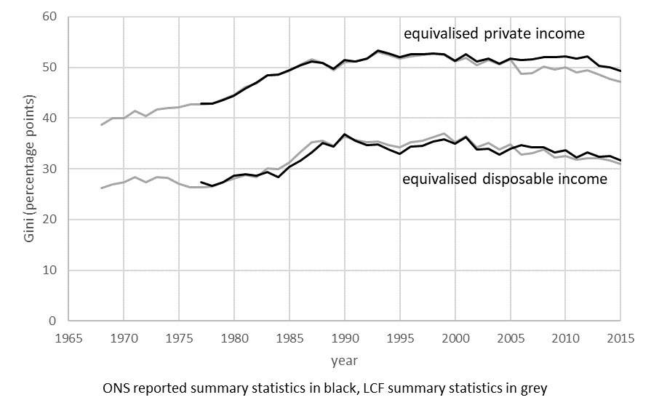
Influence of Top-Coding income
Equivalised income inequality (Gini)
Source: ONS statistics reported in statistical bulletin Effects of Taxes and Benefits on Household Income, 2015/16, Reference Table 11. LCF summary statistics based on authors’ calculations from LCF microdata.
Notes: ONS series reported between 1977 and 2015; LCF series based on data reported at annual intervals between 1968 and 2015/16 inclusive. Household income equivalised using the modified OECD scale. Data weighted by household. Survey weights included from 1996.

Slide 10
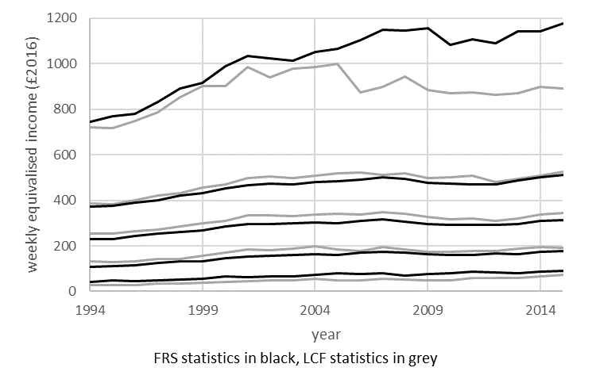
Influence of Top-Coding income
Private income quintiles (FRS vs LCF)
Source: Authors’ calculations using microdata from the Living Costs and Food (LCF) survey and Family Resources Survey (FRS), HBAI series. Prices adjusted using the National Accounts final consumption expenditure deflator, Office for National Statistics code YBGA.
Notes: Household income equivalised using the modified OECD scale. Data weighted by individual, quintiles evaluated with respect to disposable income.

Slide 11
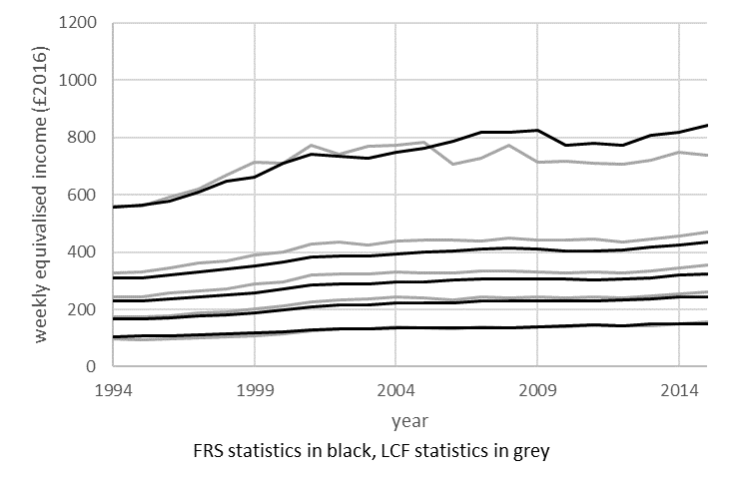
Influence of Top-Coding income
Disposable income quintiles (FRS vs LCF)
Source: Authors’ calculations using microdata from the Living Costs and Food (LCF) survey and Family Resources Survey (FRS), HBAI series. Prices adjusted using the National Accounts final consumption expenditure deflator, Office for National Statistics code YBGA.
Notes: Household income equivalised using the modified OECD scale. Data weighted by individual, quintiles evaluated with respect to disposable income.

Slide 12
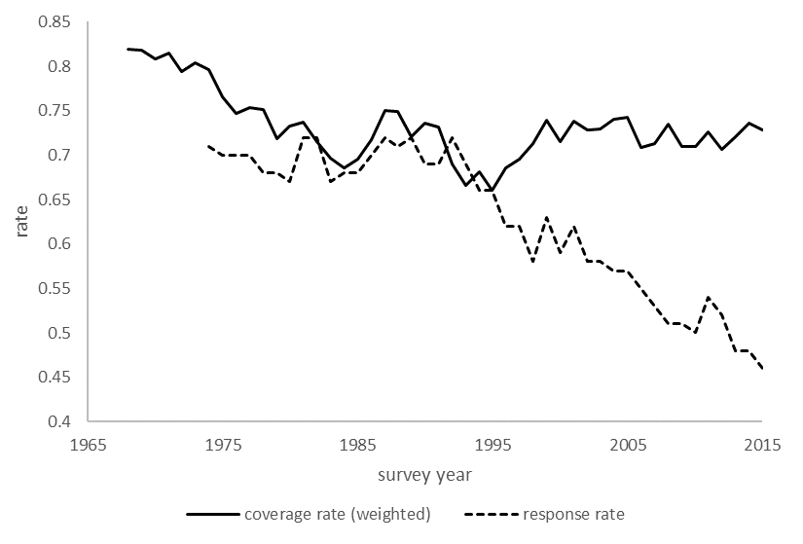
Disposable income Aggregates
Disposable income (LCF vs NAs)
Source: Survey response rates for LCF derived from Barrett et al. (2015) between 1974 and 2009, and survey technical reports between 2010 and 2015. Response rates for the FRS derived from survey technical reports. Coverage rates for disposable income based on authors’ calculations.
Notes: Coverage rates describe ratios of per-capita measures of disposable income reported by the LCF and FRS to those reported by the National Accounts. National Accounts figures based on historical series for variables QWND (disposable income of households and non-profit institutions) and EBAQ (population aggregate) reported in 2017. LCF disposable income evaluated as described in Appendix B.2 of van de Ven and Hérault (2019).

Slide 13
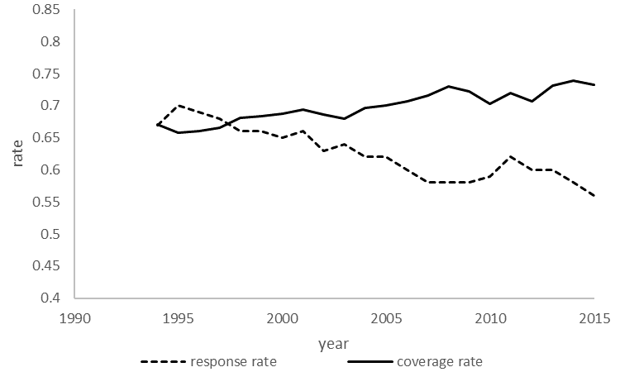
Disposable income Aggregates
Disposable income (FRS vs NAs)
Source: Survey response rates for LCF derived from Barrett et al. (2015) between 1974 and 2009, and survey technical reports between 2010 and 2015. Response rates for the FRS derived from survey technical reports. Coverage rates for disposable income based on authors’ calculations.
Notes: Coverage rates describe ratios of per-capita measures of disposable income reported by the LCF and FRS to those reported by the National Accounts. National Accounts figures based on historical series for variables QWND (disposable income of households and non-profit institutions) and EBAQ (population aggregate) reported in 2017. FRS disposable income evaluated as described in Appendix B.2 of van de Ven and Hérault (2019). FRS statistics do not include Northern Ireland prior to 2002.

Slide 14
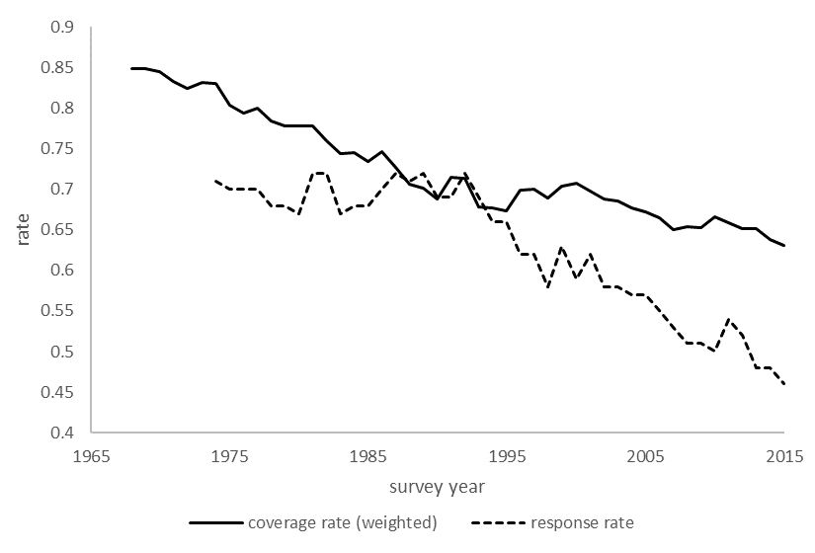
Expenditure Aggregates
Total household expenditure (LCF vs NAs)
Source: Survey response rates for LCF derived from Barrett et al. (2015) between 1974 and 2009, and survey technical reports between 2010 and 2015. Response rates for the FRS derived from survey technical reports. Coverage rates for disposable income based on authors’ calculations.
Notes: Coverage rates describe ratios of per-capita measures of total expenditure reported by the LCF to those reported by the National Accounts. National Accounts figures based on historical series for variables ABPB (Household final consumption expenditure) and EBAQ (population aggregate) reported in 2017. LCF statistics based on measures of aggregate household consumption, reported as p550tp, p508 or p378 (depending on year).

Slide 15
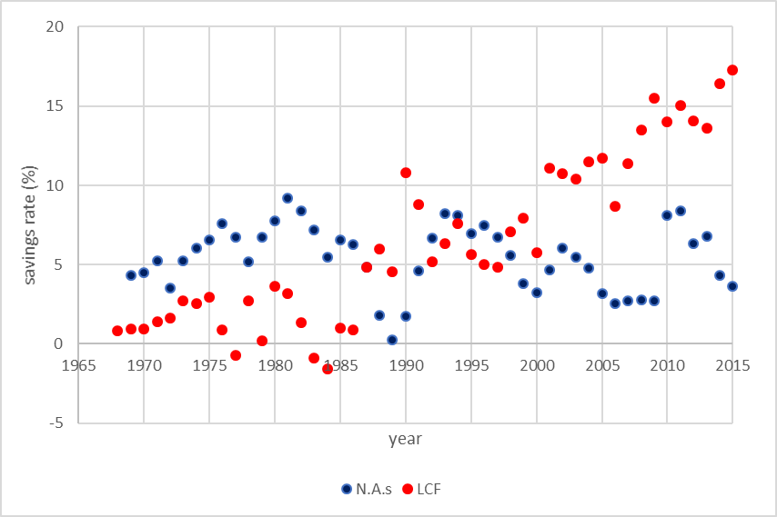
Aggregate Savings rates
Savings rates out of disposable income (LCF vs NAs)
Source: Survey response rates for LCF derived from Barrett et al. (2015) between 1974 and 2009, and survey technical reports between 2010 and 2015. Response rates for the FRS derived from survey technical reports. Coverage rates for disposable income based on authors’ calculations.
Notes: Savings rates represent ratios of aggregate disposable income in excess of consumption to disposable income for each series.

Slide 16
Summary
The UK context is interesting as there exists a relatively long time-series of publicly available micro data for analysis
  Complemented by breadth of data coverage (e.g. WAS) and convenient terms of access (UK Data Service)
The value of this resource has been reduced by (recent) limitations imposed on data access
  Especially for microsimulation purposes
The relatively long time-series raises thorny issues concerning measurement errors, and how those errors vary through time

Slide 17
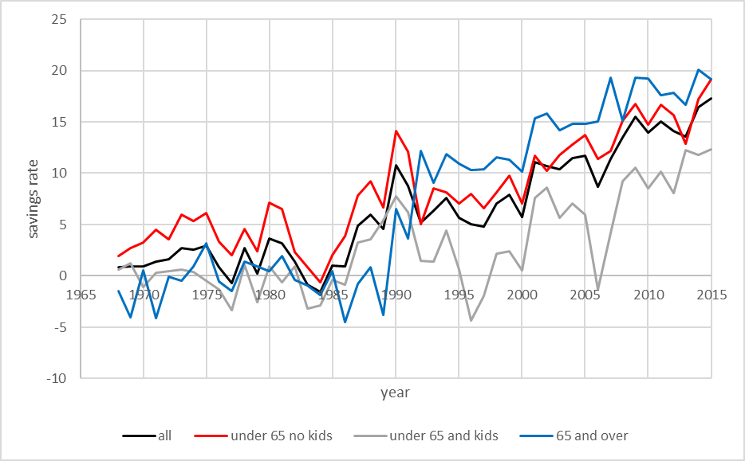
Aggregate Savings rates
Savings rates out of disposable income (LCF vs NAs)
Source: Survey response rates for LCF derived from Barrett et al. (2015) between 1974 and 2009, and survey technical reports between 2010 and 2015. Response rates for the FRS derived from survey technical reports. Coverage rates for disposable income based on authors’ calculations.
Notes: Savings rates represent ratios of aggregate disposable income in excess of consumption to disposable income for each series.

