Slide 1
LINDA and sidd
Structural dynamic microsimulation modelling at the National Institute
Justin van de Ven

Slide 2
outline
What are SIDD and LINDA?
Brief description of SIDD
Next steps

Slide 3
SIDD and linda
SIDD
  A framework for structural dynamic microsimulation modelling
    Modelling: Controlled projection to consider implications of counterfactuals
    Microsimulation: Projecting the circumstances of individual households
    Dynamic: Projecting households through time
    Structural: Labour and savings decisions based on lifecycle model
      Employs Dynamic Programming methods
LINDA
  The UK parameterisation of SIDD
  SIDD has also been set-up for other countries:
    PENSIM for Ireland
    ITALISSIMO for Italy

Slide 4
Overview of sidd
Model is now freely available for download from: www.simdynamics.org
Model generates panel data for a simulated population
  Reference cross-section projected forward and backward through time
    Necessary to build up picture of lifetime circumstances
  Evolving cross-section projected forward through time
    Requires account of migratory flows, mortality, and fertility
  Model is ideal for exploring the medium to long-term implications of policy counterfactuals
    Implications of altered incentives associated with policy alternatives
  Development supported by a wide array of funders

Slide 5
Overview of sidd
Accommodated characteristics:
year of birth* - age* -relationship status
children - student status - education level
health status - carer status - migration status
employment sector - labour income (x2) - ISA investments
business assets - pens scheme - pension wealth
BSP* - S2P - other wealth
retirement* - time of death
* denotes non-stochastic characteristics

Slide 6
Overview of sidd
Model parameters altered through Excel
  Front-end using VB in Excel provided for LINDA
Computations conducted using a stand-alone executable
  Programmed in Fortran
Outputs:
  Panel data for simulated population output in csv format
  Selected summary statistics reported in Excel files
  Data to permit replication reported in binary format

Slide 7
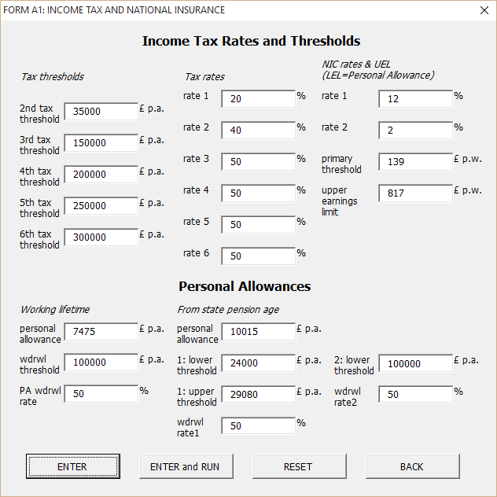
Overview of sidd

Slide 8
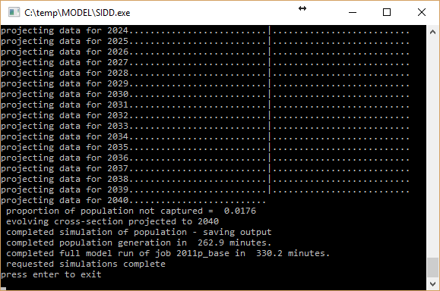
Overview of sidd

Slide 9
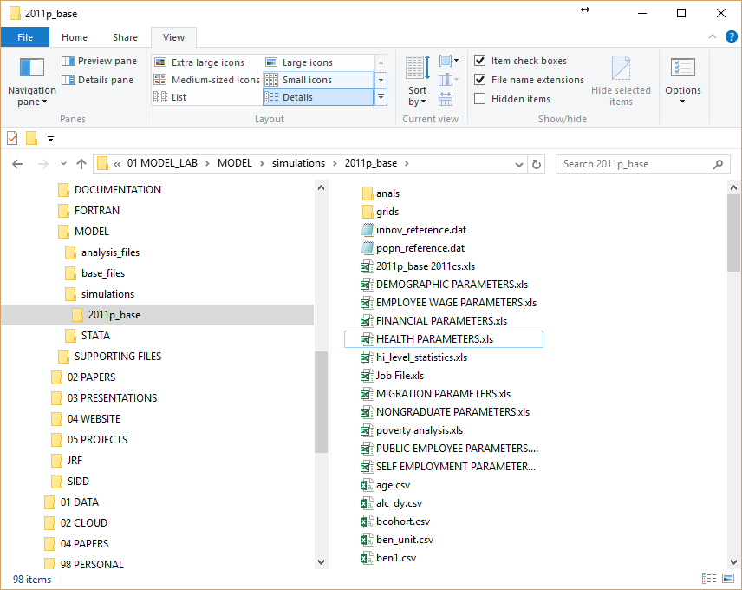
Overview of sidd

Slide 10
Overview of sidd

Slide 11
Overview of sidd

Slide 12
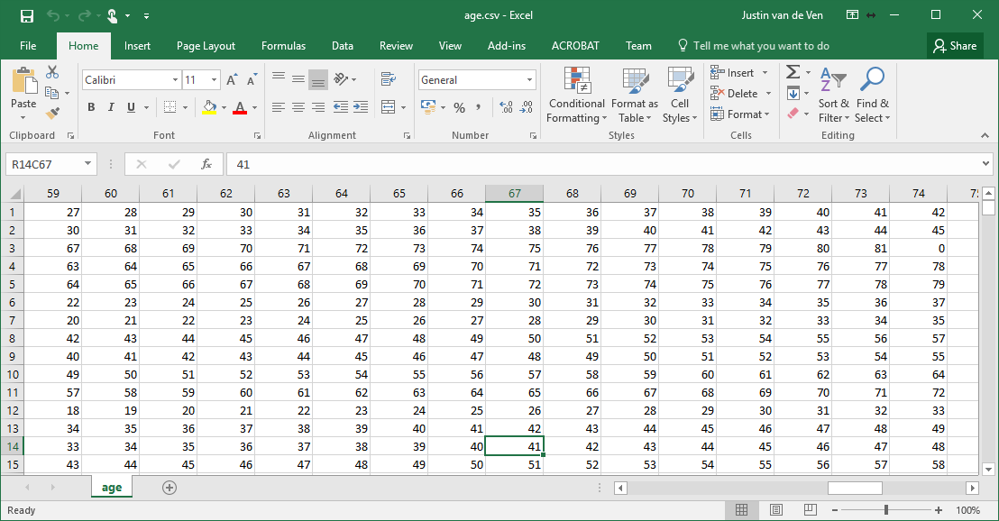
Overview of sidd

Slide 13
What next?
Developmental focus
  Expand model states to include:
    gender (moderately challenging)
    housing (very challenging)
  Macro-economic endogeneity
  Improve cloud computing integration
Academic focus
  Parameterisation
  Policy counterfactuals
Expand user-base
  A fundamental objective, both for philosophical reasons, and because of the substantive economies of scale that exist

Slide 14
Challenges of popular interpretation
Demand for certainty; for a forecast
This is not feasible with our current stage of theoretical development, and the limitations of existing computing technology
SIDD is a framework for exploring the logical implications of changing incentives embodied by policy, given a set of assumptions about how public behaviour responds to those incentives

Slide 15
Challenges of popular interpretation
It didn’t go how you said it would go
It went how it did go, and that’s fine
Take your guess,
Spurious at best,
Can’t you see it’s all just chaos.
“Take your Guess”, Tom Rosenthal

