Slide 1

Adapting the LINDA Model
Progress report to JRF, April 2015
Justin van de Ven (jvandeven@niesr.ac.uk)
Paolo Lucchino & Jonathan Portes

Slide 2

Outline
Progress to date
  Initial variant of the model delivered 16 March
  Introduction of committed expenditure complete
Next steps
  Work in progress
  Initiated collaborations

Slide 3
Preliminary Model Specification
Model variant delivered 16 March
  23 March: Guoda Cibaite started work
  Delivered model:
    updated to project from WAS data reported during the calendar year 2011
    updated policy environment
    revised model parameters
    geographic identifier introduced (ONS GORs)
    new analysis routine for projecting statistics tailored to the JRF anti-poverty program
  training sessions conducted
All features introduced into the model and empirical analyses are fully documented and associated reports are available at any time upon request

Slide 4
Preliminary Model Specification
project from WAS data reported during the calendar year 2011
  Representativeness of the WAS sample for Great Britain
  Augmenting the WAS sample for Northern Ireland

Slide 5
Evaluating Suitability of WAS
 | age specific deciles relative to population median
 | lowest | 2 | 3 | 4 | 5 | 6 | 7 | 8 | 9 | highest | poor* | Gini
 | Family Resources Survey
16-24 | 0.1684 | 0.3186 | 0.4485 | 0.5430 | 0.6485 | 0.7811 | 0.9558 | 1.1425 | 1.4050 | 2.2055 | 0.4109 | 0.3651
25-34 | 0.3051 | 0.5669 | 0.7420 | 0.9272 | 1.1022 | 1.2885 | 1.5114 | 1.8034 | 2.2487 | 3.9156 | 0.1672 | 0.3662
35-44 | 0.3086 | 0.6144 | 0.8076 | 1.0041 | 1.2219 | 1.4626 | 1.7457 | 2.1237 | 2.7447 | 5.8990 | 0.1451 | 0.4264
45-54 | 0.2927 | 0.5670 | 0.7816 | 1.0145 | 1.2604 | 1.5059 | 1.8019 | 2.1971 | 2.8396 | 5.3701 | 0.1633 | 0.4147
55-59 | 0.2347 | 0.4638 | 0.6659 | 0.8437 | 1.0752 | 1.3291 | 1.6236 | 2.0428 | 2.6783 | 4.5833 | 0.2080 | 0.4213
60-64 | 0.2452 | 0.4291 | 0.5540 | 0.6794 | 0.8307 | 1.0020 | 1.2033 | 1.4848 | 1.9041 | 3.6504 | 0.2952 | 0.4054
65-74 | 0.3024 | 0.4247 | 0.4983 | 0.5797 | 0.6724 | 0.7835 | 0.9208 | 1.1393 | 1.4594 | 2.6300 | 0.3730 | 0.3546
75+ | 0.2613 | 0.3535 | 0.4197 | 0.4837 | 0.5465 | 0.6215 | 0.7108 | 0.8360 | 1.0743 | 1.9763 | 0.5258 | 0.3292
 | Wealth and Assets Survey
16-24 | 0.1186 | 0.2819 | 0.3983 | 0.4862 | 0.5739 | 0.6937 | 0.7930 | 0.9386 | 1.1980 | 2.1393 | 0.4781 | 0.3791
25-34 | 0.2999 | 0.5731 | 0.7542 | 0.9271 | 1.0880 | 1.2784 | 1.4981 | 1.7884 | 2.1844 | 3.7803 | 0.1691 | 0.3587
35-44 | 0.2858 | 0.5557 | 0.7508 | 0.9364 | 1.1226 | 1.3271 | 1.5678 | 1.8737 | 2.3599 | 5.0100 | 0.1748 | 0.4108
45-54 | 0.2794 | 0.5422 | 0.7444 | 0.9771 | 1.1994 | 1.4444 | 1.7225 | 2.0821 | 2.5952 | 5.1364 | 0.1789 | 0.4134
55-59 | 0.2267 | 0.4267 | 0.6050 | 0.8218 | 1.0306 | 1.2778 | 1.5893 | 1.9750 | 2.4606 | 4.0849 | 0.2468 | 0.4108
60-64 | 0.2528 | 0.4031 | 0.5473 | 0.7215 | 0.9050 | 1.1038 | 1.3182 | 1.6121 | 2.1290 | 4.2925 | 0.2797 | 0.4318
65-74 | 0.2620 | 0.3757 | 0.4623 | 0.5492 | 0.6575 | 0.7914 | 0.9721 | 1.2183 | 1.5838 | 3.0841 | 0.4003 | 0.4031
75+ | 0.2248 | 0.3210 | 0.3872 | 0.4519 | 0.5197 | 0.6016 | 0.7106 | 0.8734 | 1.1476 | 2.2836 | 0.5513 | 0.3776
source: | Family Resources Survey 2011/12, omitting sample for Northern Ireland, variable HHINC
 | Wealth and Assets Survey, wave 3 reported during the calendar year 2011, variable DVTOTGIR
Notes: | * poor defined with respect to poverty line set to 60% of population median income
 | population median equals £528 per week for FRS, and £32076.40 per year for the WAS

Slide 6
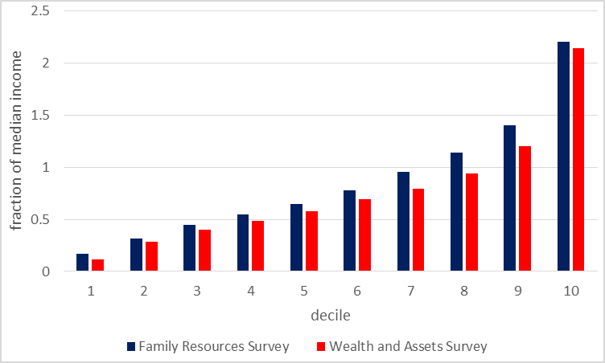
Evaluating Suitability of WAS
18 to 24 year olds

Slide 7
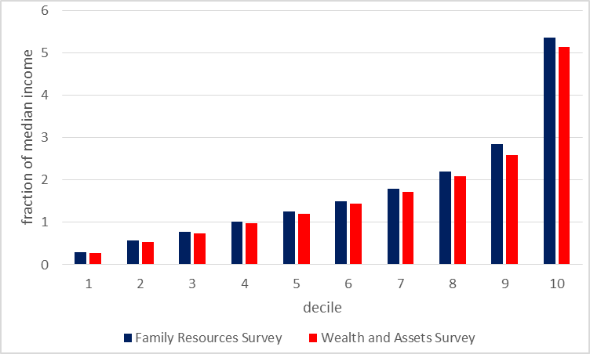
Evaluating Suitability of WAS
45 to 54 year olds

Slide 8
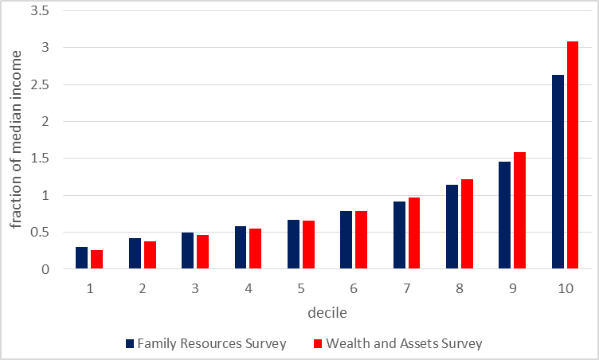
Evaluating Suitability of WAS
65 to 74 year olds

Slide 9
Allowing for Northern Ireland
A pseudo population for Northern Ireland was imputed, by randomly selecting observations reported by the WAS for Great Britain, structured to reflect the age and earnings distributions of Northern Ireland

Slide 10
Allowing for Northern Ireland
age | income quintile thresholds for Great Britain
band | lowest | 2 | 3 | 4 | highest | total
16 to 24 | 0.0226 | 0.0194 | 0.0273 | 0.0201 | 0.0122 | 0.1015
25 to 34 | 0.0577 | 0.0387 | 0.0410 | 0.0321 | 0.0258 | 0.1954
35 to 44 | 0.0591 | 0.0671 | 0.0563 | 0.0416 | 0.0271 | 0.2512
45 to 54 | 0.0510 | 0.0416 | 0.0371 | 0.0348 | 0.0225 | 0.1871
55 to 59 | 0.0233 | 0.0172 | 0.0141 | 0.0073 | 0.0048 | 0.0666
60 to 64 | 0.0138 | 0.0126 | 0.0105 | 0.0082 | 0.0068 | 0.0520
65 to 74 | 0.0255 | 0.0185 | 0.0169 | 0.0133 | 0.0077 | 0.0820
75 + | 0.0158 | 0.0157 | 0.0132 | 0.0111 | 0.0085 | 0.0641
total | 0.2688 | 0.2307 | 0.2165 | 0.1685 | 0.1153 | 1.0000
Source: | Family Resources Survey

Slide 11
Preliminary Model Specification
updated policy environment
  Designed to reflect policy in place as of April 2011
  State pension ages for men and women rise in line with existing legislation
  UC to apply from 2017
  Single-tier pension applies from 2011
    not 2016

Slide 12
Updated Policy Environment
taxes
benefits
pensions
allowing for imperfect take-up
income taxes - national insurance contributions
council tax - taxes and duties on consumption
income support - pension credit
working tax credit - child tax credit
child benefit - disability living allowance
attendance allowance - housing benefit
council tax benefit - universal credit
private pensions - state pension (single-tier)

Slide 13
Preliminary Model Specification
revised model parameters
  exogenously identified parameters
  endogenous identified parameters
policy environment - probabilities of self-employed
unemployment rates - national minimum wages
interest rates - marital rates
fertility rates - mortality rates
preferences - latent earnings

Slide 14
Revised Model Parameters
preference parameters adjusted to reflect
  Labour supply
  Consumption
  Pension scheme participation
Earnings parameters adjust to reflect sample moments for earnings

Slide 15
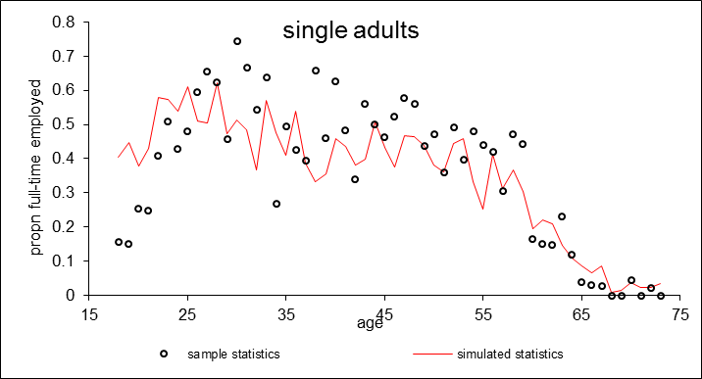
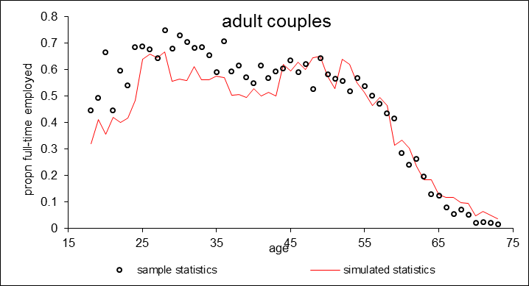
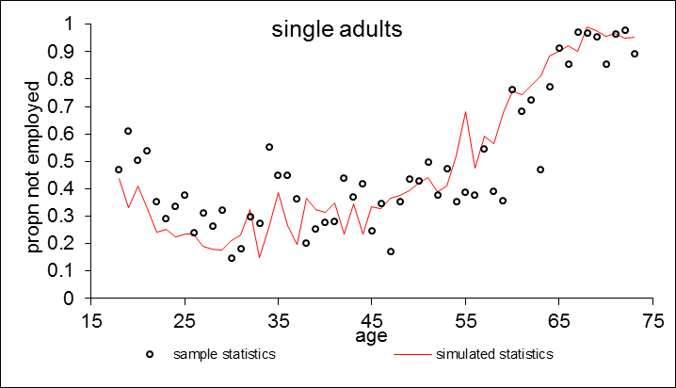
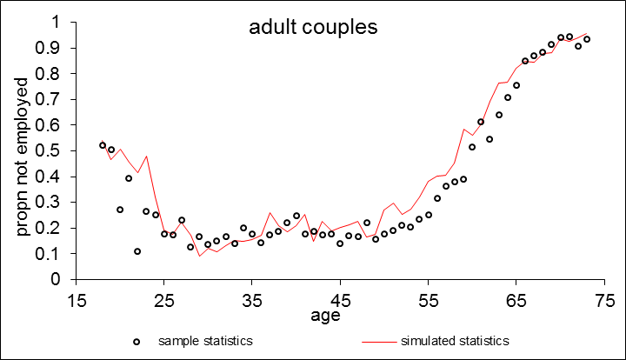
Revised Model Parameters

Slide 16
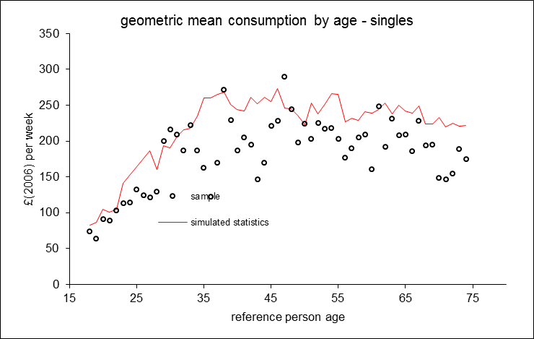
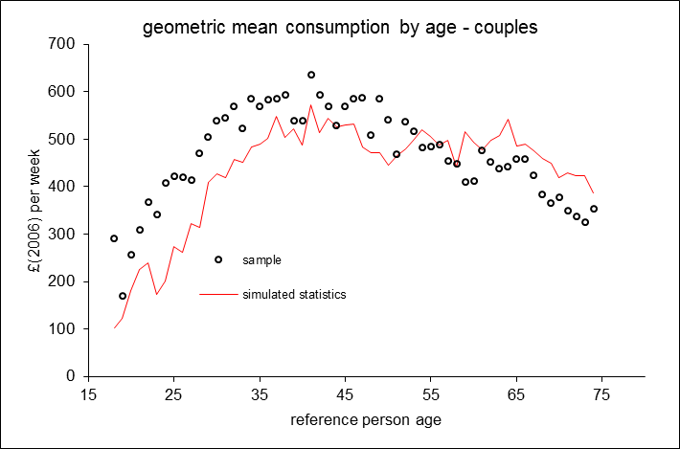
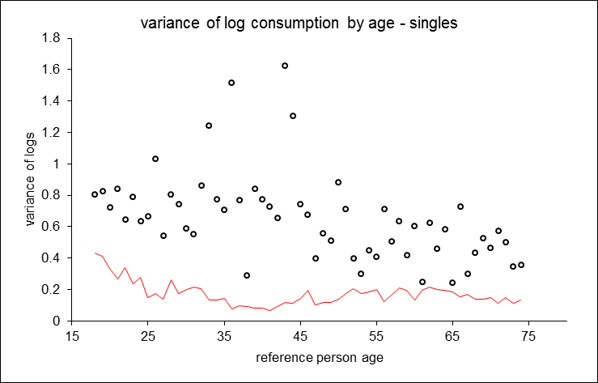
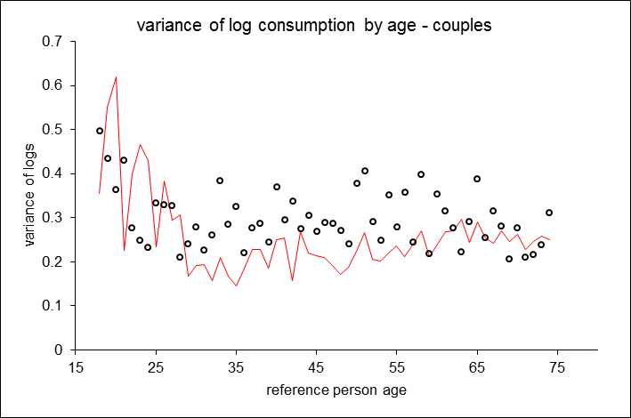
Revised Model Parameters

Slide 17
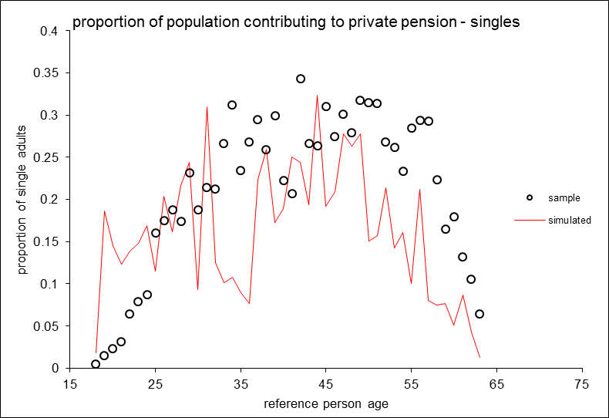
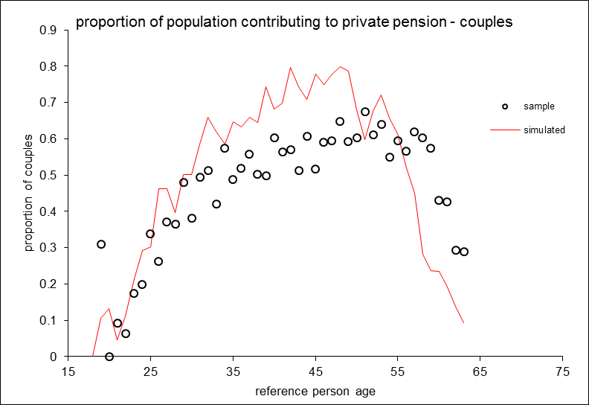
Revised Model Parameters

Slide 18
Preliminary Model Specification
geographic identifier introduced
  Regional identifiers are now included in the model projections for each benefit unit, distinguishing between 12 ONS GORs

Slide 19
Geographic Identifier
Transition probabilities for individuals resided in NE
age | North East | North West | Yorkshire and The Humber | East Midlands | West Midlands | East | London | South East | South West | Wales | Scotland | Northern Ireland
18-19 | 0.9399 | 0.0121 | 0.0210 | 0.0054 | 0.0026 | 0.0023 | 0.0045 | 0.0033 | 0.0020 | 0.0012 | 0.0055 | 0.0002
20-24 | 0.9288 | 0.0123 | 0.0175 | 0.0048 | 0.0036 | 0.0052 | 0.0111 | 0.0067 | 0.0032 | 0.0013 | 0.0039 | 0.0016
25-29 | 0.9645 | 0.0053 | 0.0071 | 0.0021 | 0.0019 | 0.0024 | 0.0075 | 0.0030 | 0.0021 | 0.0008 | 0.0029 | 0.0005
30-34 | 0.9772 | 0.0033 | 0.0044 | 0.0016 | 0.0014 | 0.0015 | 0.0040 | 0.0022 | 0.0013 | 0.0006 | 0.0021 | 0.0004
35-39 | 0.9848 | 0.0019 | 0.0031 | 0.0013 | 0.0010 | 0.0010 | 0.0022 | 0.0015 | 0.0009 | 0.0004 | 0.0016 | 0.0002
40-44 | 0.9906 | 0.0014 | 0.0020 | 0.0008 | 0.0005 | 0.0007 | 0.0010 | 0.0010 | 0.0007 | 0.0003 | 0.0010 | 0.0001
45-49 | 0.9932 | 0.0010 | 0.0014 | 0.0006 | 0.0004 | 0.0005 | 0.0006 | 0.0007 | 0.0005 | 0.0003 | 0.0009 | 0.0001
50-54 | 0.9937 | 0.0008 | 0.0015 | 0.0005 | 0.0004 | 0.0005 | 0.0004 | 0.0006 | 0.0005 | 0.0001 | 0.0008 | 0.0001
55-59 | 0.9948 | 0.0007 | 0.0014 | 0.0004 | 0.0002 | 0.0004 | 0.0003 | 0.0005 | 0.0004 | 0.0002 | 0.0007 | 0.0001
60-64 | 0.9955 | 0.0007 | 0.0011 | 0.0005 | 0.0002 | 0.0003 | 0.0001 | 0.0005 | 0.0004 | 0.0001 | 0.0006 | 0.0001
65-69 | 0.9963 | 0.0004 | 0.0008 | 0.0003 | 0.0003 | 0.0003 | 0.0002 | 0.0005 | 0.0002 | 0.0001 | 0.0005 | 0.0000
70-74 | 0.9971 | 0.0004 | 0.0006 | 0.0003 | 0.0002 | 0.0002 | 0.0002 | 0.0003 | 0.0002 | 0.0001 | 0.0003 | 0.0000
75+ | 0.9960 | 0.0006 | 0.0009 | 0.0004 | 0.0003 | 0.0003 | 0.0002 | 0.0005 | 0.0003 | 0.0001 | 0.0005 | 0.0000

Slide 20
Preliminary Model Specification
new analysis routine for projecting statistics tailored to the JRF anti-poverty program
  “poverty analysis.xls”
  reports year specific statistics for considering the relationship between redistributive policy and poverty

Slide 21
New Analysis Routine
“poverty analysis.xls”
  Poverty measures
    Absolute and relative poverty
    Cross-sectional and intertemporal (5 years)
    Consumption / disposable income before/after NDCs
    Equivalised and unequivalised
    Population subgroups
      All / children under 5 / single pensioners / pensioner couples
  Government Budget
    Income taxes, National Insurance Contributions, VAT and Excise duties, Welfare benefits
    Net tax take = taxes - benefits

Slide 22
Preliminary Model Specification
training sessions
  Paolo Lucchino has conducted two training sessions, one with Chris (Nov 2014) and the other with Guoda (Mar 2015)
Support
  We aim to respond to all queries within 24 hours (given time difference with Australia)
  We have established a Google drive for communications
    Please advise us if you would like access to this

Slide 23
Committed Expenditure
Model structure revised to accommodate
  Housing
  Childcare
  Other essential expenditure

Slide 24
Housing Expenditure
Distinguish renters from owners
Owners:
  Value of housing equity
  Value of mortgage and interest payments
Renters:
  House size and rent
Affects benefits eligibility

Slide 25
Childcare Expenditure
Childcare costs in the model are simulated based on the terms governing maximum associated transfer benefits provided under the working tax credit
Incurred if adult working fewest hours works full-time in benefit unit with at least one child aged 14 or under

Slide 26
Other Essential Expenditure
parameterised based on data reported for the 5% of benefit units with the lowest aggregate equivalised consumption
  Considered population identified within 7 age bands
  Averages of equivalised consumption net of rent and childcare costs evaluated by age band and year

Slide 27
Other Essential Expenditure
Average equivalised consumption net of childcare and rental costs of 5 per cent of benefit units with lowest equivalised total consumption, by age and year; 18-54 year olds

Slide 28
Other Essential Expenditure
Average equivalised consumption net of childcare and rental costs of 5 per cent of benefit units with lowest equivalised total consumption, by age and year; aged 55 and over

Slide 29
Other Essential Expenditure
Average disposable income of 5 per cent of benefit units with lowest equivalised total consumption by age band and year

Slide 30
Other Essential Expenditure
Average rental costs of 5 per cent of benefit units with lowest equivalised total consumption by age band and year

Slide 31
  Next Steps
Simulating Population Cross-section
  Child maturation
    Data collection in advanced stages
  International migration
    Following child maturation
Calibration
  On-going
Initiated collaborations

Slide 32
  Model Calibration
revised model parameters
  principal calibration
    a ‘balanced’ appraisal for intertemporal projections
  a negative calibration
    designed to exaggerate poverty and impose more trying conditions for the aggregate government budget

Slide 33
Model Calibration
principal calibration
a negative calibration
Box 1: differences between model calibrations
Wage growth: lower in negative calibration, especially amongst lower educated
Wage offers: less prevalent in negative calibration, especially lower educated
Rates of return: reduced in negative calibration
Migration: reduced net immigration in negative calibration
Marriages: less prevalent in negative calibration
Longevity: increased in negative calibration
Costs inflation: higher in negative calibration
Benefits growth: lower in negative calibration

Slide 34
  Initiated Collaborations
NIACE: Stephen Evans
  Exploring the potential effects of a “citizen’s skills entitlement”, including the proposed National Commitment of “shared responsibility for investment”
Heriot-Watt University: Glen Bramley
  Housing costs and regional variation
    complementary to our analysis
University of York: Roy Sainsbury
  Reforming the UC in relation to support for individuals affected by disability

Slide 35
Further Out
Health status
Endogenous education decisions
Behavioural alternatives
Consumption at individual level

