Slide 1

Using LINDA to model long-term anti-poverty strategies
Introduction to varying model parameters
and some baseline poverty projections to 2020
Justin van de Ven (jvandeven@niesr.ac.uk)
Paolo Lucchino & Jonathan Portes
December 2014

Slide 2

Outline
Defining LINDA’s scope
Using the model
Baseline poverty projections
Progress report

Slide 3
Scope of the Model
The difference between projections and forecasts

Slide 4
Scope of the Model
The difference between projections and forecasts
  Projection: An evaluation of the likely implications for a given characteristic of changes to a selected set of underlying circumstances

Slide 5
Scope of the Model
The difference between projections and forecasts
  Projection: An evaluation of the likely implications for a given characteristic of changes to a selected set of underlying circumstances
  Forecast: A prediction of the likely future state of a given characteristic

Slide 6
Scope of the Model
The difference between projections and forecasts
A projection becomes a forecast when it is calculated from a system that includes all circumstances that are considered to have an important bearing on the future state of a characteristic

Slide 7
Scope of the Model
The difference between projections and forecasts
LINDA projects a range of characteristics through time, including alternative definitions of poverty, based on an explicit set of underlying circumstances

Slide 8
Use of the Model in Practice
Each simulation is comprised of 4 discrete steps:
  Define the policy environment
  Solve for utility maximising decisions for any potential combination of benefit unit characteristics
  Simulate the circumstances of a reference population cross-section forward and backward through time, eventually building up panel data describing the complete life-history of each.
  Run secondary analyses on the panel data to explore issues of interest

Slide 9
Use of the Model in Practice
Each simulation is comprised of 4 discrete steps:
  Define the policy environment
  Solve for utility maximising decisions for any potential combination of benefit unit characteristics
  Simulate the circumstances of a reference population cross-section forward and backward through time, eventually building up panel data describing the complete life-history of each.
  Run secondary analyses on the panel data to explore issues of interest
Step 1 assisted by an Excel front-end to the model, and can be flexibly adjusted by adapting programming code

Slide 10
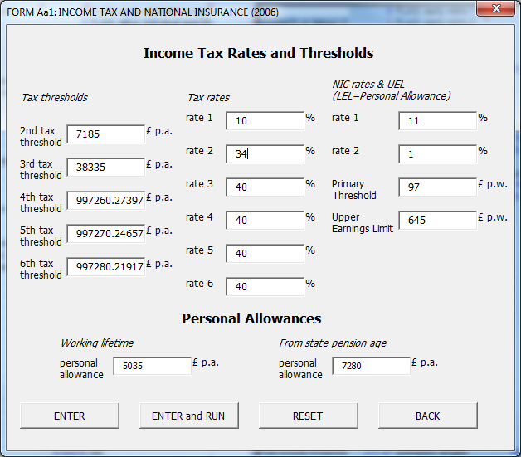
Practical example – defining parameters
Notes:
NOTE: for stated experiment make, run through front-end, and make following changes:
SHEET Aa1: basic tax rate from 22 to 34%
SHEET A4: set flat rate retirement benefits at bottom to 114.05 and 174.05, and set all PC benefits to 0
SHEET C1: uncheck BSP (CP1)

Slide 11
Use of the Model in Practice
Each simulation is comprised of 4 discrete steps:
  Define the policy environment
  Solve for utility maximising decisions for any potential combination of benefit unit characteristics
  Simulate the circumstances of a reference population cross-section forward and backward through time, eventually building up panel data describing the complete life-history of each.
  Run secondary analyses on the panel data to explore issues of interest
Steps 2 and 3 automated by the model

Slide 12
Use of the Model in Practice
Each simulation is comprised of 4 discrete steps:
  Define the policy environment
  Solve for utility maximising decisions for any potential combination of benefit unit characteristics
  Simulate the circumstances of a reference population cross-section forward and backward through time, eventually building up panel data describing the complete life-history of each.
  Run secondary analyses on the panel data to explore issues of interest
Step 4 assisted by automated production of a standard set of statistics

Slide 13
Baseline Poverty Projections
Poverty: when a person’s resources (mainly their material resources) are not sufficient to meet their minimum needs (including social participation)
The model in its current form is reasonably well adapted to permit analysis of poverty as defined above.
  The model includes a broad description of material resources, including income and wealth
  The model includes a measure of family consumption that responds to needs in respect of the number of family members, childcare and housing costs, and the associated bearing of employment.

Slide 14
Baseline Poverty Projections
Using standard poverty-line methods, it is possible to describe measures of poverty with reference to a wide range of alternative statistics:
  Threshold variables
    disposable income / gross income / consumption / available funds
    equivalised / non-equivalised
    pre / post non-discretionary expenditure
  Time frame
    annual to lifetime
  Units of analysis
    benefit units
    people
    children – by age
  Disaggregation by
    age / year / education / relationship status / self-employment / temporal dynamics

Slide 15
Baseline Poverty Projections
Using standard poverty-line methods, it is possible to describe measures of poverty with reference to a wide range of alternative statistics:
  Threshold variables
    disposable income / gross Income / consumption / available funds
    equivalised / non-equivalised
    pre / post non-discretionary expenditure
  Time frame
    annual to lifetime
  Units of analysis
    benefit units
    people
    children – by age
  Disaggregation by
    age / year / education / relationship status / self-employment / temporal dynamics

Slide 16
Baseline Poverty Projections
Using standard poverty-line methods, it is possible to describe measures of poverty with reference to a wide range of alternative statistics:
  Threshold variables
    disposable income / gross Income / consumption / available funds
    equivalised / non-equivalised
    pre / post non-discretionary expenditure
  Time frame
    annual to lifetime
  Units of analysis
    benefit units
    people
    children – by age
  Disaggregation by
    age / year / education / relationship status / self-employment / temporal dynamics

Slide 17
Baseline Poverty Projections
Limitations on projection of population medians

Slide 18
Baseline Poverty Projections
Limitations on projection of population medians

Slide 19
Baseline Poverty Projections
Limitations on projection of population medians

Slide 20
Baseline Poverty Projections
Poverty: under 60% of annual disposable equivalised benefit unit income

Slide 21
Baseline Poverty Projections
Poverty: under 60% of annual disposable equivalised benefit unit income

Slide 22
Baseline Poverty Projections
Poverty: under 60% of annual disposable equivalised benefit unit income

Slide 23
Baseline Poverty Projections
Poverty: under 60% of average equivalised disposable income

Slide 24
Baseline Poverty Projections
Poverty: under 60% of average equivalised disposable income

Slide 25
Baseline Poverty Projections
Poverty: under 60% of average equivalised disposable income

Slide 26
Baseline Poverty Projections
Poverty: under 60% of average equivalised disposable income

Slide 27
Baseline Poverty Projections
Poverty: under 60% of average equivalised disposable income

Slide 28
Baseline Poverty Projections
Poverty: under 60% of average equivalised disposable income

Slide 29
Baseline Poverty Projections
Poverty: under 60% of average equivalised disposable income

Slide 30
Extending LINDA
The model will be adapted to better explore poverty over time by:
  extending the model to project the evolving population cross-section
  disaggregating consumption to the individual level
    adjusting for a measure of minimum “needs” (committed expenditure)
  inclusion of health status as an individual descriptive characteristic
  endogenous decisions concerning higher education
We will also:
  update the model to project from data observed during the year July 2011 to June 2012
  amend the model to permit alternative assumptions to be considered concerning behaviour

Slide 31
Extending LINDA
The model will be adapted to better explore poverty over time by:
  extending the model to project the evolving population cross-section
  disaggregating consumption to the individual level
    adjusting for a measure of minimum “needs” (committed expenditure)
  inclusion of health status as an individual descriptive characteristic
  endogenous decisions concerning higher education
We will also:
  update the model to project from data observed during the year July 2011 to June 2012
  amend the model to permit alternative assumptions to be considered concerning behaviour

